Slide 1

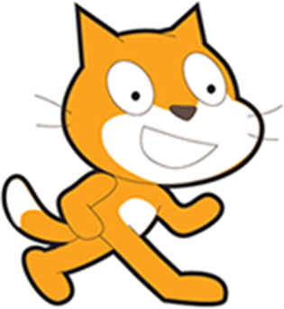
Welcome to Intermediate
scratch.mit.edu
Warmup: Change Bat Away into Beach Bounce
Review: Script blocks
Introduce: Messages
Introduce: Data and Variables
Maybe: Clones
Showcase your projects

Slide 2
Goals
Goals for the next 2 weeks
FUN! Learn more of the fun things you can do with Scratch
Learn more of the basics of writing software using Scratch (because Scratch is more fun and easy than just about anything else I’ve seen.)
Topics will include Messages, Variables, Clones, “More Blocks”
Topics may use tools more deeply, like the drawing panel and importing graphics

Slide 3
What is programming?
Teaching something that is pretty dumb
to do something that seems smart
When programming, remember that computers do exactly what you tell them.

Slide 4
Tonight’s Project: Beach Ball Bounce!
An earlier project was “Bat Away” or “Pong” and right after this slide, we’ll change it to “Beach Ball Bounce”
A sprite (bat, beach ball) moves around the stage
The player uses the paddle to prevent the ball from slipping through.
If the sprite gets past the paddle: GAME OVER
“5 minute” Warm up: Change the graphics
Then: A quick review on script blocks.
First improvement: Game Start state (“Click to begin”) by Messages
Later: Messages and .. Show your project!

Slide 5
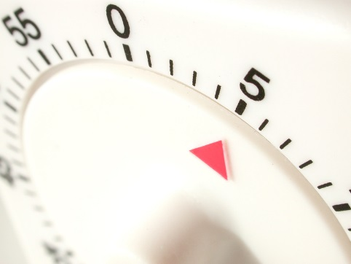
5-minute Warmup! Change Bat Away into Beach Ball Bounce
Go to scratch.mit.edu and sign in if you have an account.
Start with tinyurl.com/scratch-remixme
or: http://scratch.mit.edu/projects/61514792/
Change the background
I chose ‘Beach at Malibu’ from the built-in backgrounds
Change the bat sprite to a beach ball
Scratch has one available. I have a nice one hidden.
Or, draw or import your own.

Slide 6
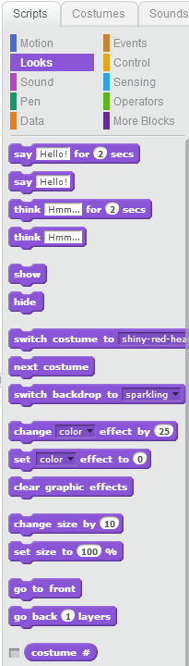
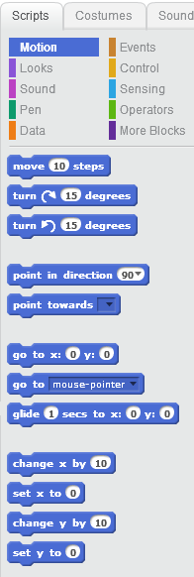
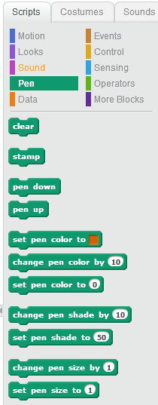
A quick refresher on Scripts
Motion
Pen /
Drawing
Looks:

Slide 7
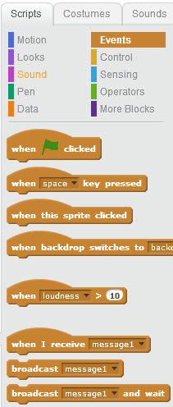
Events
The MOST USEFUL events are
When the Green Flag is clicked
When a keyboard key is pressed
When a sprite is clicked
Now, Introducing messages

Slide 8

“Secret” Messages (events to broadcast and receive)
Sprites don’t normally talk to each other
(think of pong’s ball and paddle)
BUT, you can add your own secret message
Broadcasting and Receiving Messages is the way to pass information
Could it make Beach Ball Bounce better?
The paddle doesn’t know if the sprite goes out of bounds
(remember, it missed the paddle).
The sprite (ball, bat) DOES know
Let it tell anything that listens!

Slide 9
Beach Ball Bounce – next steps
Game Start screen
Make an opening message that disappears when the game starts.
You can do this without sending a message. How? (Tip: when should the beach ball start moving? Extra tip: use the space bar.)
Game End screen
When the ball makes it past the paddle and touches the bottom, it should send a message out. The ‘end of game’ sprite should appear and all others should disappear.
Stuck? Look at scratch.mit.edu/projects/61731480

Slide 10
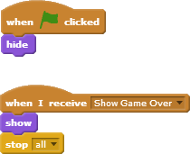
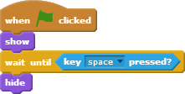
Add a message to Beach Ball Bounce
I added a “Show Game Over” message
What do you think these scripts do. Should they all go on the paddle??
(psst: no!)
What if I suggested to add a
“Starting Message” sprite
and a “Game Over” sprite

Slide 11
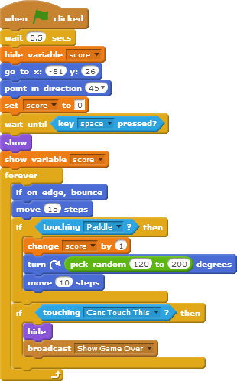
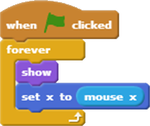
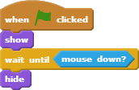
Here are my scripts
Stuck? Look at scratch.mit.edu/projects/61731480
Initial code
for the main sprite
(the ball)
On the paddle:
Game loop code in
A forever block
On a Start Game sprite:
On a Game Over sprite:

Slide 12
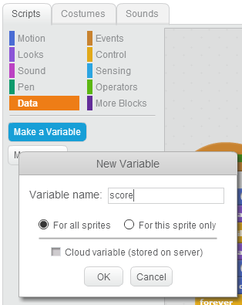
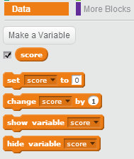
Data. Also called Variables
If you have information that changes, use “variables”
What data might you want in a game like Beach Ball Bounce ?
Smallest change: Add the score (a ‘bounce’ count)
Use the checkbox to have it automatically display
Later, maybe a “lives:” counter. Bonus Points if you do it tonight!

Slide 13
Next steps:
Most games give you multiple lives.
What topics did we cover which would help?
I’m thinking that we might have a variable called “lives”
We set it to ‘3’ on green flag, decrement when the ball gets past the paddle, and send ‘show game over’ when it drops to zero.
How could we ‘refactor’ the code so we can
Restart the game on a space bar press (& change user messages)
We must remove the ‘stop all’
I think I need a new event-message called “Start Game”
I think I could merge all the information sprites (“How to start”, “Game over”) into one sprite. I would make the 2nd costume in the sprite (“Game Over, play again?”)
I think we need a new, 3rd “You missed. Ready to try again?” message in the info sprite
I would put message handlers on that sprite to set the correct costume to match the messages.
Try to make some of these changes to your project!
Stuck? Look at scratch.mit.edu/projects/61731480

Slide 14
Next week: Cloning
Cloning can turn Pong into Breakout
http://scratch.mit.edu/projects/10101023/
Asteroids is a different game, but once you learn cloning, you know all the Scratch you need to do it. (Do you know all the math you need?)
Here’s the starter version:
http://scratch.mit.edu/projects/14542009/
Here’s a mostly finished version:
http://scratch.mit.edu/projects/17450708/
But for the rest of the evening,
please show your projects!

